Slide 1
Association Rule Mining
BY
E.Sivasankar

Slide 2



Mining association rules in large databases
The discovery of interesting association relationships amount huge amounts of business transaction records can help in many business decision making process such as catalogue design, cross-marketing and loss-leader analysis.
Eg.
Computer financial_management_software
[support = 2%, confidence = 60%]
support A B = P ( A U B)
confidence A B = P (B/A)

Slide 3
Rules support and confidence are two measures of interestingness. They reflect the usefulness and certainty of discovered rules.
A support 2% for association rule means that 2% of all the transactions under analysis show that computer and financial management software are purchased together.
A confidence of 60% means that 60% of the customers who purchased a computer also bought the software.
Typically, association rules are considered interesting if
they satisfy both a minimum support threshold and
a minimum confidence threshold.

Slide 4


The rule A B holds in the transaction set D with support s, where s is the percentage of transactions in D that
contain A U B
The rule A B has confidence c in the transaction set D, where c is the percentage of transactions in D containing A that also contain B. This is taken to be the conditional probability, P(B/A).

Slide 5
Apriori Algorithm: Finding Frequent Itemsets
by Confined Candidate Generation
Apriori is a seminal algorithm proposed by R. Agrawal and R. Srikant in 1994 for mining frequent itemsets for Boolean association rules.
The name of the algorithm is based on the fact that the algorithm uses prior knowledge of frequent itemset properties.
First, the set of frequent 1-itemsets is found by scanning the database to accumulate the count for each item, and collecting those items that satisfy minimum support. The resulting set is denoted by L1.

Slide 6
Next, L₁ is used to find L₂, the set of frequent 2-itemsets, which is used to find L₃, and so on, until no more frequent k-item sets can be found. The finding of each L_{k} requires one full scan of the database.
To improve the efficiency of the level-wise generation of frequent item sets, an important property called the Apriori property is used to reduce the search space.
Apriori property: All nonempty subsets of a frequent itemset must also be frequent.

Slide 7

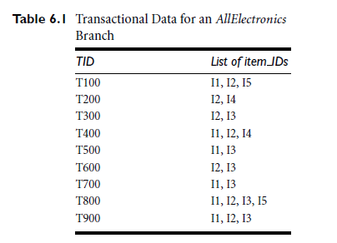

Slide 8
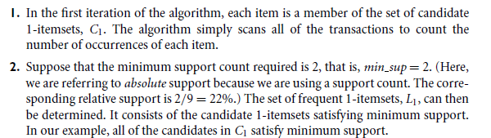
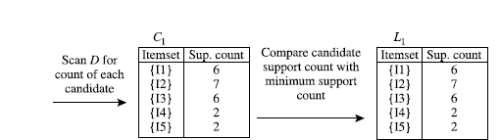

Slide 9

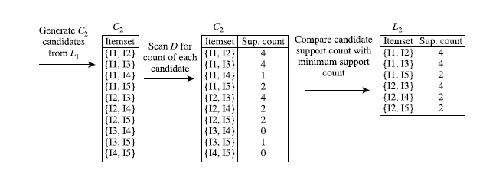

Slide 10
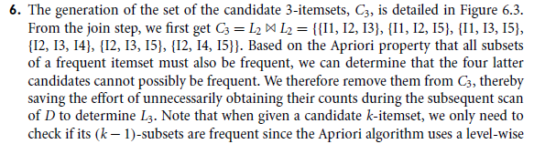
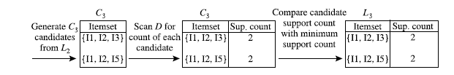

Slide 11
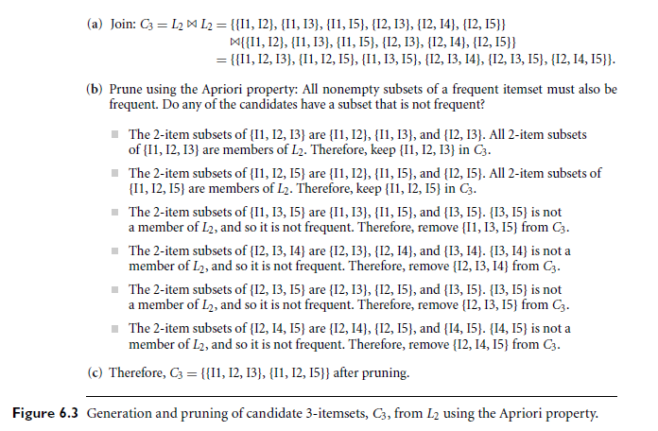

Slide 12
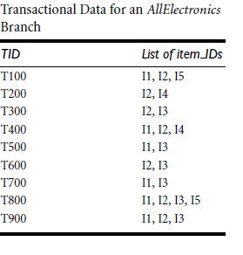
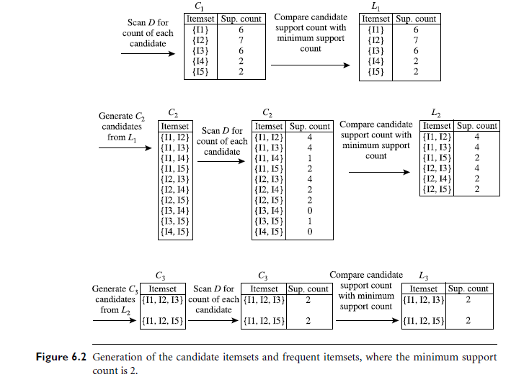

Slide 13


Slide 14
Apriori Algorithm
The Apriori algorithm takes a bottom-up iterative approach to uncovering the frequent item sets by first determining all the possible items (or 1-itemsets, for example {bread}, {eggs}, {milk}, …) and then identifying which among them are frequent.
Assuming the minimum support threshold (or the minimum support criterion) is set at 0.5, the algorithm identifies and retains those itemsets that appear in at least 50% of all transactions and discards (or “prunes away”) the itemsets that have a support less than 0.5 or appear in fewer than 50% of the transactions.
The word prune is used like it would be in gardening, where unwanted branches of a bush are clipped away.

Slide 15
Apriori Algorithm
In the next iteration of the Apriori algorithm, the identified frequent 1-itemsets are paired into 2-itemsets (for example, {bread, eggs}, {bread, milk}, {eggs, milk}, …) and again evaluated to identify the frequent 2-itemsets among them.

Slide 16
Apriori Algorithm
The first step of the Apriori algorithm is to identify the frequent itemsets by starting with each item in the transactions that meets the predefined minimum support threshold δ. These itemsets are 1-itemsets denoted as L1, as each 1-itemset contains only one item.
Next, the algorithm grows the itemsets by joining L1 onto itself to form new, grown 2-itemsets denoted as L2 and determines the support of each 2-itemset in L2.

Slide 17
Apriori Algorithm
Those itemsets that do not meet the minimum support threshold δ are pruned away.
The growing and pruning process is repeated until no itemsets meet the minimum support threshold.
Optionally, a threshold N can be set up to specify the maximum number of items the itemset can reach or the maximum
number of iterations of the algorithm.
Once completed, output of the Apriori algorithm is the collection
of all the frequent k-itemsets.

Slide 18
Applications of Association Rules
Many online service providers such as Amazon and Netflix use recommender systems.
Recommender systems can use association rules to discover related products or identify customers who have similar
interests.
For example, association rules may suggest that those customers who have bought product A have also bought product B, or those customers who have bought products A, B, and C are more similar to this customer.
These findings provide opportunities for retailers to cross-sell their products.

Slide 19
Validation and Testing
After gathering the output rules, it may become necessary to use one or more methods to validate the results in the business context for the sample dataset.
The first approach can be established through statistical measures such as confidence, lift, and leverage. Rules that involve mutually independent items or cover few transactions are considered uninteresting because they may capture spurious relationships.
confidence measures the chance that X and Y appear together in relation to the chance X appears. Confidence can be used to identify the interestingness of the rule.

Slide 20
Validation and Testing
Lift and leverage both compare the support of X and Y against their individual support. While mining data with association rules, some rules generated could be purely coincidental.
For example, if 95% of customers buy X and 90% of customers buy Y, then X and Y would occur together at least 85% of the
time, even if there is no relationship between the two.
Measures like lift and leverage ensure that interesting
rules are identified rather than coincidental ones.

Slide 21
Validation and Testing
Even with a high confidence, a rule may be considered subjectively uninteresting unless it reveals any unexpected profitable actions.
For example, rules like {paper}→{pencil} may not be subjectively interesting or meaningful despite high support and confidence values.
In contrast, a rule like {diaper}→{beer} that satisfies both minimum support and minimum confidence can be considered subjectively interesting because this rule is unexpected and may suggest a cross-sell opportunity for the retailer.

Slide 22
Applications of Association Rules
● Broad-scale approaches to better merchandising—what products should be included in or excluded from the inventory each month.
● Cross-merchandising between products and high-margin or high-ticket items.
● Physical or logical placement of product within related categories of products.
● Promotional programs—multiple product purchase incentives managed through a loyalty card program

Slide 23
Applications of Association Rules
Clickstream analysis refers to the analytics on data related to web browsing and user clicks, which is stored on the client or the server side.
Web usage log files generated on web servers contain huge
amounts of information, and association rules can potentially give useful knowledge to web usage data analysts.

Slide 24
Here are some approaches to improve Apriori’s efficiency:
● Partitioning: Any itemset that is potentially frequent in a transaction database must be frequent in at least one of the partitions of the transaction database.
● Sampling: This extracts a subset of the data with a lower support threshold and uses the subset to perform association rule mining.
● Transaction reduction: A transaction that does not contain frequent k-itemsets is useless in subsequent scans and therefore can be ignored.
.

Slide 25
● Hash-based itemset counting: If the corresponding hashing bucket count of a k-itemset is below a certain threshold, the k-itemset cannot be frequent.
● Dynamic itemset counting: Only add new candidate itemsets when all of their subsets are estimated to be frequent

Slide 26
Mining Frequent Itemsets Using the Vertical Data Format
Both the Apriori and FP-growth methods mine frequent patterns from a set of transactions in TID-itemset format .
(i.e., {TID : itemset}), where TID is a transaction ID and itemset is the set of items bought in transaction TID. This is known as the horizontal data format.
Alternatively, data can be presented in item-TID_set format
(i.e., {item : TID_set}), where item is an item name, and TID_ set is the set of transaction identifiers containing the item. This is known as the vertical data format.

Slide 27
First, we transform the horizontally formatted data into the
vertical format by scanning the data set once.
The support count of an itemset is simply the length of the TID set of the itemset.
Starting with k =1, the frequent k-itemsets can be used to construct the candidate (k +1)itemsets based on the Apriori property
The computation is done by intersection of the TID sets of the frequent k-itemsets to compute the TID sets of the corresponding (k +1)-itemsets.
This process repeats, with k incremented by 1 each time, until no frequent itemsets or candidate itemsets can be found.

Slide 28
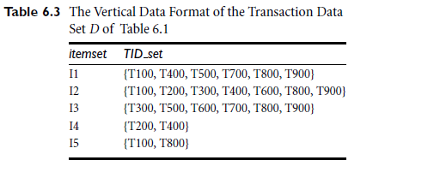
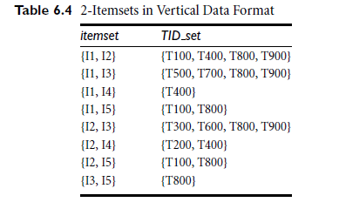

Slide 29
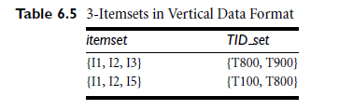

Slide 30
Association rule mining is a two step process :
1.Find all the frequent item sets
By definition, each of these item sets will occur at leased as frequently as a predetermined minimum support count.
2.Generate strong association rules from the frequent item sets.
By definition, these rules must support minimum support and confidence

Slide 31

Classification of association rule mining
1.Based on the levels of abstraction involved in the rule set :
In Rules (7.1) and (7.2), the items bought are referenced at different abstraction levels (e.g., “computer” is a higher-level abstraction of “laptop computer,” and “color laser printer” is a lower-level abstraction of “printer”). We refer to the rule set mined as consisting of multilevel association rules.
If, instead, the rules within a given set do not reference items or attributes at different abstraction levels, then the set contains single-level association rules.

Slide 32

2. Based on the dimension of data involved in the rule :
If the items or attributes in an association rule reference only one dimension then it is a single-dimensional association rule.
If a rule references two or more dimensions such as time of transaction, customer category, then it is a multi-dimensional association rule.
Eg.
age (x, “30…39”) ^ income (x, “50k…60k”) buys (x, high resolution TV)

Slide 33
3.Based on the types of values handled in the rule :
If a rule concerns association between the presence or absence of items, rule (7.1) & (7.2) it is a Boolean association rule.
If the rule describes association between quantitative items or attributes, then it is a quantitative association rule.
Ex-rule (7.3)

Slide 34
4. Based on the constraints or criteria used to mine selective patterns:
The patterns or rules to be discovered can be constraint-based (i.e., satisfying a set of user defined constraints), approximate, compressed, near-match (i.e., those that tally the support count of the near or almost matching itemsets), top-k (i.e., the k most frequent itemsets for a user-specified value, k),

Slide 35
